Slide 1


Noida Institute of Engineering and Technology, Greater Noida7
Database Management System
Unit: 01
Introduction
Dr. SHAINA
ASSISTANT PROFESSOR
CSE(IOT) DEPARTMENT
CSE– 4 SEM

Slide 2
Content
Database System Vs File System
Data Model Schema and Instances
Data Independence and Database Languages
Data Modeling using Entity Relationship Model
Keys
Specialization, Generalization and Aggregation
Reduction of an ER diagram to Tables
Extended ER Model.

Slide 3
Course Objective
To learn features of a database system and its application and compare various types of data models.
To construct an ER Model for a given problem and transform it into a relation database schema.
To formulate solution to a query problem using SQL Commands, relational algebra, tuple calculus and domain calculus.
To learn the need of normalization and normalize a given relation to the desired normal form.
To learn different approaches of transaction processing and concurrency control.

Slide 4
Course Outcome
After successful completion of this course student will able to
COURSE OUTCOME NO | COURSE OUTCOMES
CO1 | Describe the features of a database system and its application and compare various types of data models.
CO2 | Construct an ER Model for a given problem and transform it into a relation database schema.
CO3 | Formulate solution to a query problem using SQL Commands, relational Algebra, tuple calculus and domain calculus.

Slide 5
Course Outcome
After successful completion of this course student will able to
COURSE OUTCOME NO | COURSE OUTCOMES
CO4 | Explain the need of normalization and normalize a given relation to the desired normal form.
CO5 | Explain different approaches of transaction processing and concurrency control, NOSQL.

Slide 6
CO-PO Mapping
PO No CO No | PO1 | PO2 | PO3 | PO4 | PO5 | PO6 | PO7 | PO8 | PO9 | PO10 | PO11 | PO12
CO1 | 1 | 3 | 3 | 1 | 2 |  |  |  |  | 1 | 1 | 1
CO2 | 3 | 3 | 3 | 1 | 1 |  |  |  |  | 1 | 1 | 1
CO3 | 3 | 2 | 1 | 2 | 2 |  |  |  |  | 1 | 1 | 1
CO4 | 2 | 2 | 1 | 2 | 2 |  |  |  |  | 2 | 1 | 1
CO5 | 3 | 3 | 3 | 3 | 3 |  |  | - |  | 2 | 1 | 1
3: STRONG 2: MEDIUM
1: WEAK

Slide 7
Unit Objective
To introduce the concepts of database and to learn the concepts of ER Model.

Slide 8
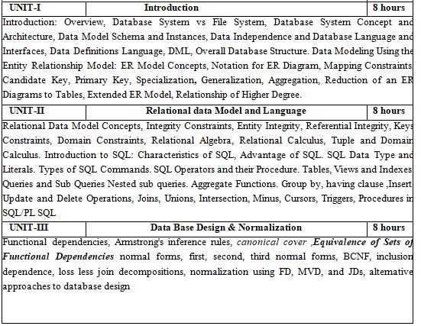
Course content/Syllabus

Slide 9
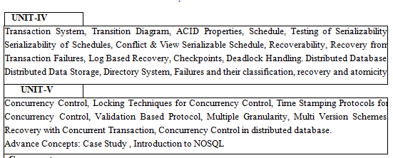
Course content/Syllabus

Slide 10
Introduction to Database
A Database is a collection of related Data.
A Database Management System is a collection of programs that enables users to create and maintain a database.
A Data Model is a Collection of Concepts that can be used to describe the structure of a database.
By Structure of a Database We mean
- Data Types
- Relationships
- Constraints that hold on the data.

Slide 11
Users of Database
DBA – Database Administrator
Chief Administrator to oversee and arrange the resources
The primary resource is the database itself
The secondary resource is DBMS and S/w
Responsibilities
Authorizing access to the database
Coordinating and Monitoring its Use
Acquring S/w and H/w as needed
Security
Poor Response Time

Slide 12
Users of Database
Database Designers: Responsible for Identifying the data to be stored in the database and for choosing appropriate structures to represent and store this data.
The Database Designers find out the Requirements of the user and then make the appropriate design meeting those requirements.
End Users : They query, update and generate reports
Casual – Sophisticated DB Query Language, Managers
Naïve – Limited Queries: Bank tellers, Reservation Clerks
Sophisticated – Engineers , Scientists
Stand Alone – Personal Database, e.g Tax Package.

Slide 13
Database Systems vs File Systems
Data redundancy and inconsistency – Duplication of Information in Files. Suppose Name and Age in one file and name and Rollno in another file.
Data sharing – File system does not allow sharing of data or sharing is too complex. Whereas in DBMS, data can be shared easily due to centralized system.
Data concurrency – Concurrent access to data means more than one user is accessing the same data at the same time. Anomalies occur when changes made by one user gets lost because of changes made by other user. File system does not provide any procedure to stop anomalies. Whereas DBMS provides a locking system to stop anomalies to occur.
Data searching – For every search operation performed on file system, a different application program has to be written. While DBMS provides inbuilt searching operations. User only have to write a small query to retrieve data from database.

Slide 14
Database Systems vs File Systems
Data integrity – There may be cases when some constraints need to be applied on the data before inserting it in database. The file system does not provide any procedure to check these constraints automatically. Whereas DBMS maintains data integrity by enforcing user defined constraints on data by itself.
System crashing – In some cases, systems might have crashes due to various reasons. It is a bane in case of file systems because once the system crashes, there will be no recovery of the data that’s been lost. A DBMS will have the recovery manager which retrieves the data making it another advantage over file systems.
Data security – A file system provides a password mechanism to protect the database but how longer can the password be protected? No one can guarantee that. This doesn’t happen in the case of DBMS. DBMS has specialized features that help provide shielding to its data.

Slide 15
Characteristics of Database Systems
Traditionally, data was organized in file formats. DBMS was a new concept then, and all the research was done to make it overcome the deficiencies in traditional style of data management. A modern DBMS has the following characteristics −
Real-world entity − A modern DBMS is more realistic and uses real-world entities to design its architecture. It uses the behavior and attributes too. For example, a school database may use students as an entity and their age as an attribute.
Relation-based tables − DBMS allows entities and relations among them to form tables. A user can understand the architecture of a database just by looking at the table names.
Isolation of data and application − A database system is entirely different than its data. A database is an active entity, whereas data is said to be passive, on which the database works and organizes. DBMS also stores metadata, which is data about data, to ease its own process.
Less redundancy − DBMS follows the rules of normalization, which splits a relation when any of its attributes is having redundancy in values. Normalization is a mathematically rich and scientific process that reduces data redundancy.

Slide 16
Characteristics of Database Systems
Consistency − Consistency is a state where every relation in a database remains consistent. There exist methods and techniques, which can detect attempt of leaving database in inconsistent state. A DBMS can provide greater consistency as compared to earlier forms of data storing applications like file-processing systems.
Query Language − DBMS is equipped with query language, which makes it more efficient to retrieve and manipulate data. A user can apply as many and as different filtering options as required to retrieve a set of data. Traditionally it was not possible where file-processing system was used.
ACID Properties − DBMS follows the concepts of Atomicity, Consistency, Isolation, and Durability (normally shortened as ACID). These concepts are applied on transactions, which manipulate data in a database. ACID properties help the database stay healthy in multi-transactional environments and in case of failure.
Multiuser and Concurrent Access − DBMS supports multi-user environment and allows them to access and manipulate data in parallel. Though there are restrictions on transactions when users attempt to handle the same data item, but users are always unaware of them.

Slide 17
Characteristics of Database Systems
Multiple views − DBMS offers multiple views for different users. A user who is in the Sales department will have a different view of database than a person working in the Production department. This feature enables the users to have a concentrate view of the database according to their requirements.
Security − Features like multiple views offer security to some extent where users are unable to access data of other users and departments. DBMS offers methods to impose constraints while entering data into the database and retrieving the same at a later stage. DBMS offers many different levels of security features, which enables multiple users to have different views with different features. For example, a user in the Sales department cannot see the data that belongs to the Purchase department. Additionally, it can also be managed how much data of the Sales department should be displayed to the user. Since a DBMS is not saved on the disk as traditional file systems, it is very hard for miscreants to break the code.

Slide 18
Data Models
Categories of Data Models: The data models can be categorized according to the types of concepts they use to describe the database structure.
High Level or Conceptual: Provide Concepts that are close to the way many users perceive data.
Low Level or Physical: Provide Concepts that describe the details of how data is stored in the computer.
Conceptual Data Models use concepts such as entities, attributes and relationships.
Entity: Represents a real world object or concept such as employee or a project.
Attribute: Represents some property of interest that further describes an entity such as employee name or salary.

Slide 19
Data Models
A Relationship: Among two or more entities represents an interaction among the entities. E.g. Works-on relationship between an employee and a project.
Schemas, Instances and Database State
In any Data Model, it is important to distinguish between the
Description of the database and the Database Itself.
The description of the database is called the Database Schema, which is specified during the database design and is not expected to change frequently.
The data in the database at a particular moment in time is called the Database State or a snapshot.
It is also Called an Instance in the database.

Slide 20
Daily Quiz
DBMS is a ?
System Software
Application Software
General Software
Both A and C
Which of the following command is the task of DBA
Create Tables
Delete Tables
Performance monitoring
Both A and B

Slide 21
Daily Quiz
Data Model are?
High Level
Low Level
Medium level
Both A and B
Database Schema is
Structure of database
Describes Databse
Populates the Database
Both A and B

Slide 22
Daily Quiz
Database Designers do the following ?
Gather requirements
Build the schema
Provide passwords
Both A and B
What are the advantages of DBMS
Create Tables
Removing Redundancy
Removing Inconsistency
Both B and C

Slide 23
DBMS Architecture
DBMS Architecture
The DBMS design depends upon its architecture. The basic client/server architecture is used to deal with a large number of PCs, web servers, database servers and other components that are connected with networks.
The client/server architecture consists of many PCs and a workstation which are connected via the network.
DBMS architecture depends upon how users are connected to the database to get their request done.

Slide 24
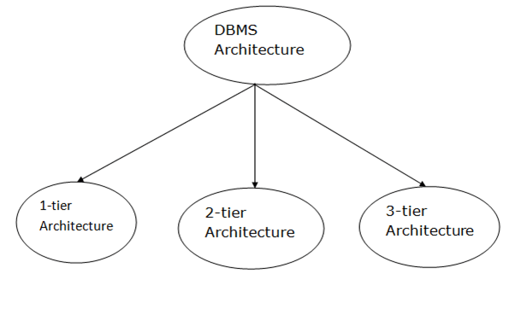
Database State
Types of DBMS Architecture

Slide 25
1-Tier Architecture
1-Tier Architecture
In this architecture, the database is directly available to the user. It means the user can directly sit on the DBMS and uses it.
Any changes done here will directly be done on the database itself. It doesn't provide a handy tool for end users.
The 1-Tier architecture is used for development of the local application, where programmers can directly communicate with the database for the quick response.

Slide 26
2-Tier Architecture
2-Tier Architecture
The 2-Tier architecture is same as basic client-server. In the two-tier architecture, applications on the client end can directly communicate with the database at the server side. For this interaction, API's like: ODBC, JDBC are used.
The user interfaces and application programs are run on the client-side.
The server side is responsible to provide the functionalities like: query processing and transaction management.
To communicate with the DBMS, client-side application establishes a connection with the server side.

Slide 27
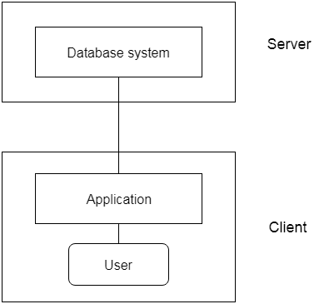
2-Tier Architecture

Slide 28
3- tier Architecture
3-Tier Architecture
The 3-Tier architecture contains another layer between the client and server. In this architecture, client can't directly communicate with the server.
The application on the client-end interacts with an application server which further communicates with the database system.
End user has no idea about the existence of the database beyond the application server. The database also has no idea about any other user beyond the application.
The 3-Tier architecture is used in case of large web application.

Slide 29
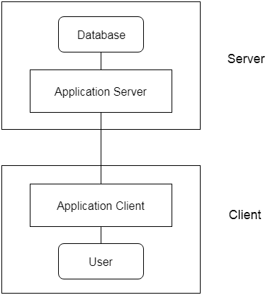
3- tier Architecture

Slide 30
Database State
Each Schema has its own set of records or set of Instances. When we add or delete a record from a database, the instance changes or we change the state of the database to another state.
The DBMS stores the descriptions of the schema constructs and constructs are also called the meta-data in the DBMS catalog so that DBMS software can refer to the schema whenever it needs to.
The Schema is called Intension and the data inside it is called Extension

Slide 31
The Three Schema Architecture
Types of Schema
The different types of schemas are as follows −
Physical schema − It is a database design at the physical level. It is hidden below the logical schema and can be changed easily without affecting the application programs.
Logical schema − It is a database design at the logical level. Programmers construct applications using logical schema.
External − It is schema at view level. It is the highest level of a schema which defines the views for end users.
Generally the Database Management System (DBMS) assists one physical schema, one logical schema and several sub or external schemas.

Slide 32
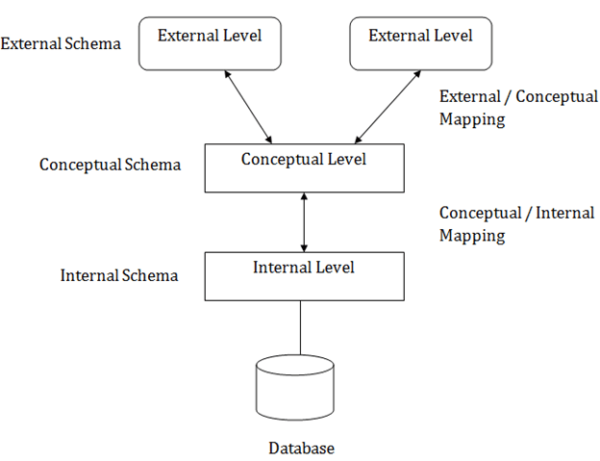
The Three Schema Architecture

Slide 33
Database Schema
STUDENT
Name | Student_no | Class | major
COURSE
Course_Name | Course_no | Credit_Hours | Department

Slide 34
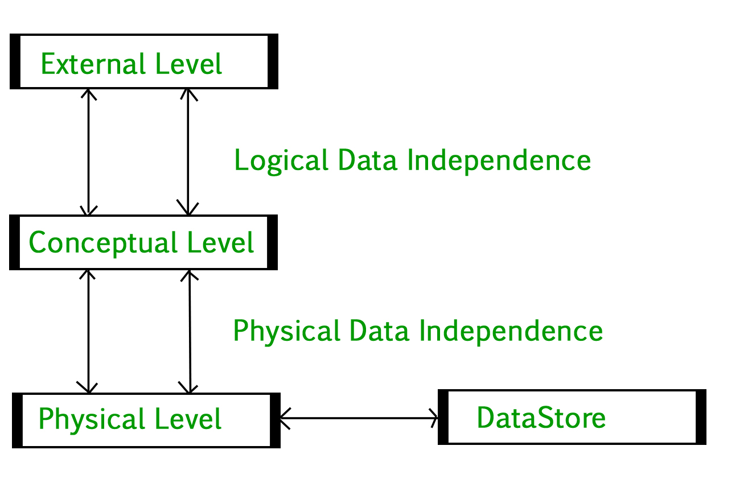
The Three Schema Architecture

Slide 35
Data Independence
The External or View Level: includes a number of external schemas or user views. Each external schema describes the part of the database that a user group is interested in and hides the rest of the database from that user group.
Data Independence: Defined as the capacity to change the schema at one level of the database system without having to change the schema at the next higher level.
Logical Data Independence: is the capacity to change the conceptual schema without having to change the external schema or application programs.

Slide 36
Data Independence
Now the view remains the same even if the conceptual schema undergoes a logical reorganization.
Physical Data Independence: is the capacity to change the internal schema without having to change the conceptual schemas. Here physical files have to be reorganized to improve performance and access paths may need to be changed.
Database Languages and Interfaces:
Data Definition Language (DDL): this is used by the DBA and the database designers to define both schemas.

Slide 37
Logical Data Independence
Student Name | Student Transcript
 | Course_Number | Grade | Section Id
Smith | CS1310 | C | 119
Brown | CS1340 | A | 95
Brown | CS3320 | B | 112
Sec Id | Course
112 | CS3320
119 | CS1310
95 | CS1340
Student Name | Student number
Smith | 8
Brown | 17
Student_No | Section Id | Grade
17 | 112 | B
8 | 119 | C
17 | 92 | A
Student_no | Student_Name | Section_Id | Course_on | Grade
17 | Brown | 112 | CS3320 | B
8 | Smith | 119 | CS1310 | C
17 | Brown | 95 | CS1340 | A

Slide 38
Database Languages and Interfaces:
DDL is used to specify the Conceptual Schema
SDL ( Storage Definition Language) is used to specify the internal schema.
VDL ( View Definition Language) is used to specify the user views.
DML ( Data Manipulation Language): Once the database schemas are compiled and the database is populated with data, users must have some means to manipulate the database.
- Typical manipulations include Retrieval , Insertion, Deletion
and Modification of the data.

Slide 39
Data Manipulation Language
A High Level or Non Procedural DML: Can be used on its own to specify complex database operations in a consise manner. E.g. SQL.
A Low Level or Procedural DML: must be embedded in a general purpose programming language. This type of DML typically retrieves individual records or objects from the database and processes each separately.
DML commands are embedded in a general purpose programming language, that language is called the host language and the DML is called the data sublanguage.
A high level DML used in a stand alone interactive manner is called a query language.
Example SQL is one which uses DML, VDL and DDL.

Slide 40
Daily Quiz
Which one of the following is a type of Data Manipulation Command?
Create
Alter
Delete
All of the above
Which of the following command is a type of Data Definition language command?
Create
Update
Delete
Merge

Slide 41
Daily Quiz
To remove a relation from an SQL database, we use the ______ command. 1)Delete 2)Purge 3)Remove 4)Drop table
Insert into Student values(‘abc’, 10, 20)
What type of statement is this? a) Query b) DML c) Relational d) DDL

Slide 42
Daily Quiz
The basic data type char(n) is a _____ length character string and varchar(n) is _____ length character.
A. Fixed, equal
B. Equal, variable
C. Fixed, variable
D. Variable, equal
Select * from employee What type of statement is this?
A. DML
B. DDL
C. View
D. Integrity constraint

Slide 43
Overall Database Structure
DBA Staff Casual User Application Programs
DDL St
Interactive Query Application
DDL Compiler Query Compiler Programs
System Catalog Pre Compiler Data Dictionary
D DML Statements
Runtime Database Processor DML Compiler
Stored Database

Slide 44
Overall Database Structure
1. Query Processor : It interprets the requests (queries) received from end user via an application program into instructions. It also executes the user request which is received from the DML compiler. Query Processor contains the following components –
DML Compiler – It processes the DML statements into low level instruction (machine language), so that they can be executed.
DDL Interpreter – It processes the DDL statements into a set of table containing meta data (data about data).
Embedded DML Pre-compiler – It processes DML statements embedded in an application program into procedural calls.
Query Optimizer – It executes the instruction generated by DML Compiler.

Slide 45
Overall Database Structure
2. Storage Manager : Storage Manager is a program that provides an interface between the data stored in the database and the queries received. It is also known as Database Control System. It maintains the consistency and integrity of the database by applying the constraints and executes the DCL statements. It is responsible for updating, storing, deleting, and retrieving data in the database. It contains the following components –
Authorization Manager – It ensures role-based access control, i.e,. checks whether the particular person is privileged to perform the requested operation or not.
Integrity Manager – It checks the integrity constraints when the database is modified.
Transaction Manager – It controls concurrent access by performing the operations in a scheduled way that it receives the transaction. Thus, it ensures that the database remains in the consistent state before and after the execution of a transaction.
File Manager – It manages the file space and the data structure used to represent information in the database.
Buffer Manager – It is responsible for cache memory and the transfer of data between the secondary storage and main memory.

Slide 46
Overall Database Structure
3. Disk Storage: It contains the following components –
Data Files – It stores the data.
Data Dictionary – It contains the information about the structure of any database object. It is the repository of information that governs the metadata.
Indices – It provides faster retrieval of data item.

Slide 47
Data Modeling Using the Entity Relationship Model
ER Model : This is a high level conceptual model used for the conceptual design.
Example Database in Company:
The company is organized into departments. Each department has a unique name, a unique number and a particular employee who manages the department.
A start-date when employee began managing the department and the department has several locations.
A department controls a number of projects, each of which has a unique name, a unique number and a single location.

Slide 48
Data Modeling Using the Entity Relationship Model
4) Each Employees name, social security number, address, salary and birth-date is stored.
5) An employee is assigned to the department but may work on several projects, which are not necessarily controlled by the same department.
6) A track is kept of the no of hours per week that all employee works on each project.
7) Track of the direct supervisor of each employee is also kept.
8) The dependants of each employee for insurance purposes is also kept. Dependant’s first name, birth-date and relationship to the employee is also kept.

Slide 49
Entities and Attributes
An Entity is a thing in the real world with independent existence. An entity may be an object with a physical existence. A particular person, car, house or employee.
Each entity has attributes – the particular properties that describe it. Each entity will have value for each of its attributes.
Like Name
Address
Age
Phone

Slide 50
Attributes
Composite Attributes : Can be divided into smaller subparts which represents more basic attributes with independent meanings.
E.g. Address is a composite attribute, it can be subdivided into Street, Address, City, State and Zip. with values “2311 Janak Puri, Delhi, Delhi 110021”.
Attributes that are not divisible are called Atomic Attributes or simple attributes e.g. Number, Department Number.
Single Value : Most attributes have a single value for a particular entity, such attributes are called Single-Valued.
Age is a single value attribute of a person.

Slide 51
Attributes
In some cases an attribute can have a set of values for the same entity. For example a College Degree attribute for a person. Example a person may have more than one college degree, such attributes are called multivalued.
Stored Vs Derived: In some cases two or more attribute values are related. For Example, the Age and Birth-Date attributes of a person. For a particular person entity, the value of age can be determined from the current (today’s) date
and the value of that person’s Birth Date.

Slide 52
Attributes
The Age attribute is therefore Derived and
The Birth-Date attribute is Stored.
NULL Values: In some cases a particular entity may not have an applicable value for an attribute. E.g College Degree is only meant for people having a college degree. The ones that do not have it will store null values into it.
Complex Attributes: Combination of composite and multivalued attributes.

Slide 53
Entity Types, Entity Sets, Keys and Value Sets
Entity Types: A database usually contains groups of entities that are similar. For example, a company employing hundreds of employees may want to store similar information concerning each of the employees. This is Entity type called Employee.
Entity Sets: The collection of all entities of a particular entity type in the database at any point in time is called an entity set.
An Entity Type usually has an attribute whose values are distinct for each individual entity in the collection. Such an attribute is called a Key Attribute and its values can be used to identify each entity uniquely.

Slide 54
Key Attribute of an Entity Type
E.g. the Social Security Number of an employee.
Value Sets ( Domains ) of Attributes: Each simple attribute of an entity type is associated with a value set ( or domain of values ) which specifies the set of values that may be assigned to that attribute for each individual entity. E.g. the age of employee can be between 16 – 70. So the value set for that attribute can be between 16 -70.

Slide 55
Daily Quiz
Which one of the following is not an attribute type?
Complex
composite
multivalued
none of the above
Which of the following denotes a row in a relation?
Entity
Entity Type
Entity Set
None of the above

Slide 56
Daily Quiz
Which of the following is the property of a key ? 1)Unique 2)Not Null 3)Inconsistent 4)both A and B
Which one is the property of a domain
a) Alphanumeric b) Integers c) The set of values d) Both B and C

Slide 57
Daily Quiz
The Derived attribute
A. need not be stored
B. must be stored
C. may or maynot be stored
D. none of the above
Which one of the following can be broken down
A. Composite attribute
B. multivalued attribute
C. complex attribute
D. both A and C

Slide 58
Conceptual Design of the Company Database
Entity Type Department with attributes, Name
Number, Location, Manager and Manager Start Date,
Locations is a multivalued attribute.
Entity Type Project with attribute Name, Number, Location and Controlling Department.
Entity Type Employee with attributes Name, SSN, Address, Salary, Birth-Date, Department, and Supervisor. Both Name and Address are Composite Attributes.
Entity Type Works-On is a Multivalued, Composite attribute of Employee
Entity Type Dependant with attributes Employee, Dependant Name, Birth-Date and Relationship.

Slide 59
Conceptual Design of the Company Database
DNAME
EMPLOYEE
MBER
LOCATION
WORKS_ON R
DEPENDENT
DEPARTMENT
DNAME | DNUMBER | LOCATION | MANAGER | MANAGER_ST_DATE
PROJECT]
PNAME | PNUMBER | LOCATION | CONTROLLING_DEPT
NAME | SSN | ADDRESS | SALARY | BIRTH_DATE | DNO | SUPERVISOR
ESSN | PNO | HOURS
ESSN | DEP_NAME | BIRTH_DATE | RELATIONSHIP
T

Slide 60
Relationship, Relationship Types, Roles and Structural Constraints
A relationship is many a times implicit. Whenever an attribute of one entity type refers to another entity type, some relationship exists.
E.g Manager of Department refers to an Employee who manages the Department.
- The attribute department of employee refers
to the department for which the employee
work.
- In ER-Model, these references should not be
represented as attributes but as relationships.
- Each of the individual entities e₁ e₂ e_{3…..} e_{n.}
is said to participate in the relationship
instance.

Slide 61
Relationship, Relationship Types, Roles and Structural Constraints
Degree of a relationship type is the number of participating entity types.
- works_on relationship is of degree 2
- two degree relationship is called binary
- supply relationship is of degree 3
- three degree is called ternary.
Relationship as Attributes:
In the works_on relationship we can put the name of
the department in the employee table.

Slide 62
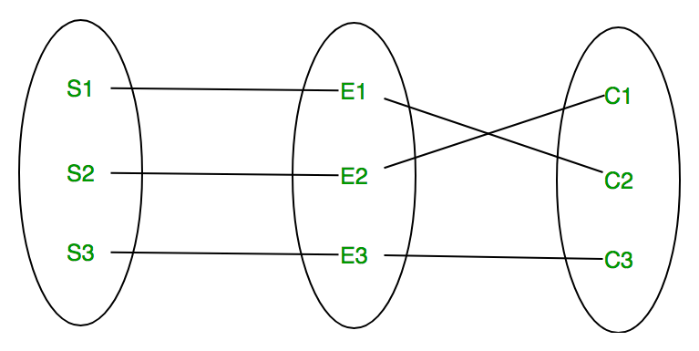
Relationship Type and Relationship Instance

Slide 63
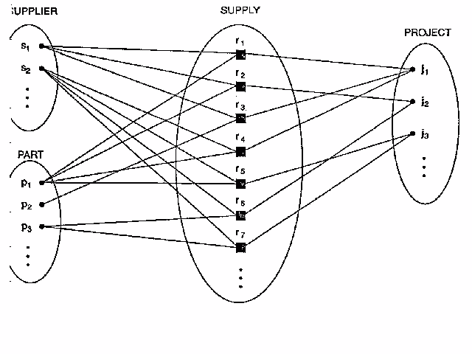
Relationship Type and Relationship Instance

Slide 64
Relationship as Attributes
Relationship as Attributes:
In the works_on relationship we can put the name of
the department in the employee table. And that will
represent the departmentin which that employee is
working.
we put manager in department table and that
represents the manager who manages the
department.

Slide 65
Roles
Roles:
Each entity type that participates in a relationship
type plays a particular role in a relationship.
In works_on relationship, the employee plays the
role of a worker or employee and the department
plays the role of department.
In some cases, the same entity type participates in
more than once in a relationship type in different
roles. These are called recursive relationship.

Slide 66
Roles
The supervisor relationship type relates an employee
to a supervisor, where both employee and supervisor
entities are members of the same employee entity
type.
The employee entity type participates twice in
supervision. Once in the role of supervisor and once
In the role of supervisee.

Slide 67
Daily Quiz
Which of the following describes a relationship?
Relationship type
Relationship Set
Relationship Instance
none of the above
What does relationship instance mean?
Joining entities from different entity type
Joining two entity types
Joining two instances of an entity
None of the above

Slide 68
Daily Quiz
What is relationship as an attribute 1)A relationship type 2)A relationship Instance 3)An attribute of a relationship type 4)none of the above
What is a role
a) A relationship b) An entity c) an attribute d) none of the above

Slide 69
Daily Quiz
Relationship can be represented as
A. Attributes
B. Values
C. entities
D. records
What is a recursive relationship?
A. A relationship with degree 2
B. A relationship with degree 3
C. A relationship with only one entity type
D. None of the above

Slide 70
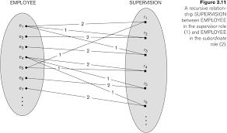
Roles ( Recursive Relationships)

Slide 71
Constraints on Relationship Types
Relationship types usually have certain constraints
that limit the possible combinations of entities
that may participate in the corresponding relationship
set.
e.g. if a company has a rule that each employee must
work for exactly one department, then we would like
to describe this constraint in the schema.
There are 2 main types of constraints:
Cardinality Ratio
Participation

Slide 72
Constraints on Relationship Types
Cardinality Ratio : The cardinality ratio for a binary
relationship specifies the number of relationship
instances that an entity can participate in.
E.g. In works_for relationship type , Department :
Employee is of cardinality ratio 1:N
Meaning that each department can employee many employees,
But an employee works_for only one department.
The possible binary relationship types can have the cardinality ratios
as 1:1 , 1:N, M:N.

Slide 73
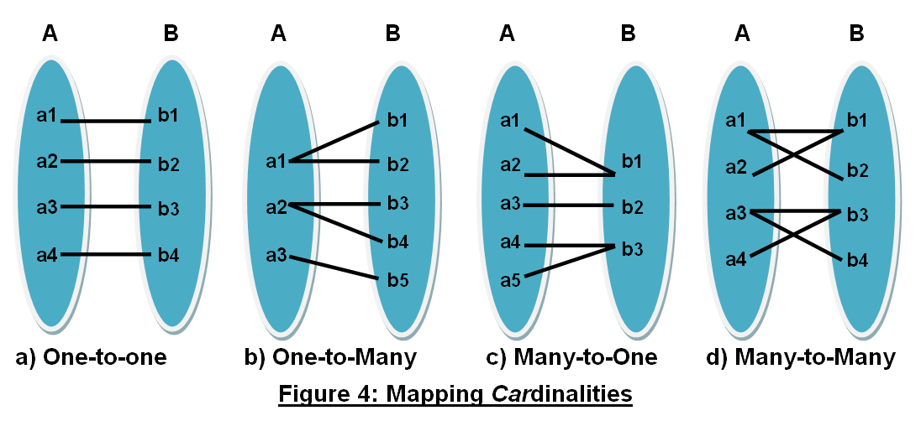
Cardinality Ratio 1:N

Slide 74
Constraints on Relationship Types
Example of 1:1 relationship is Manages which relates
a department entity to the employee who manages
the department.
i.e. an employee can manage only one
department and the department can have
only one manager.
Example of M:N relationship is works_on. An
employee can work_on many projects and a project
can have several employees.

Slide 75
Constraints on Relationship Types
Participation: The participation constraint specifies
weather the existence of an entity depends on its
being related to another entity in the relationship
type.
There are two types of participation constraint :
1) Total
2) Partial
If a company policy states that every employee must
work for a department, then an employee entity can
exist only if it participates in a works_for relationship
instance.

Slide 76
Constraints on Relationship Types
Thus the participation of employee in a works_for is
called total participation.
we do not expect every employee to manage a
department. So the participation of employee in
manages is partial.
Attributes of relationship type:
Example to record the number of hours per week that
an employee work on a particular project. We can
include an attribute hours for the works_on
relationship type.

Slide 77
Constraints on Relationship Types
To include the data on which the manager started
managing a department is an attribute of start_date
on the manages relationship.
Notice that the attributes of 1:1 or 1:N relationship
types can be migrated to one of the participating
entity types.
e.g.start_date attribute for manages relationship can
be an attribute of either employee or department.
for 1:N relationship the attribute should go to the Nth
Side.

Slide 78
Daily Quiz
Which one of the following is a type of relationship constraint?
1:1
1:N
M:N
All of the above
Which of the following is a type of relationship constraint?
Total
partial
Both A and B
None of the above

Slide 79
Daily Quiz
Which of the following constraints leads to the creation of a new table 1)1:1 2)N:M 3)1:N 4)total
Which of the following constraints leads to putting Null Values
a) 1:1 b) 1:N c) N:M d) Partial

Slide 80
Daily Quiz
Which of the following would lead to creation of a new table
A. 1:N
B. Relationship of degree two
C. Relationship of degree 3
D. All of the above
A relationship type ____________?
A. May have Attributes
B. Must have attributes
C. Cannot have attributes
D. None of the above

Slide 81
Constraints on Relationship Types
For M:N , the attribute should remain with the
relationship type.
Weak Entity Type: entities that do not have key
attributes of their own are called
weak entity types.
Weak Entity types have total participation, e.g. is
dependents of the employee.

Slide 82
Redefine the Database
1) Manages – 1:1 relationship between employee and
department. Dept is total. Employee
part is partial.
2) Works_for – 1:N Department and Employee.
participation is total for both.
3) Controls – 1:N between Department and Project.
Project – total
Department – Partial
4) Supervision – 1:N employee and employee
both participation is partial.
5) Works-on – M:N between employee and project.
6) Dependents – 1:M relationship between employee
and dependent.
Employee – Partial
Dependent - Total

Slide 83
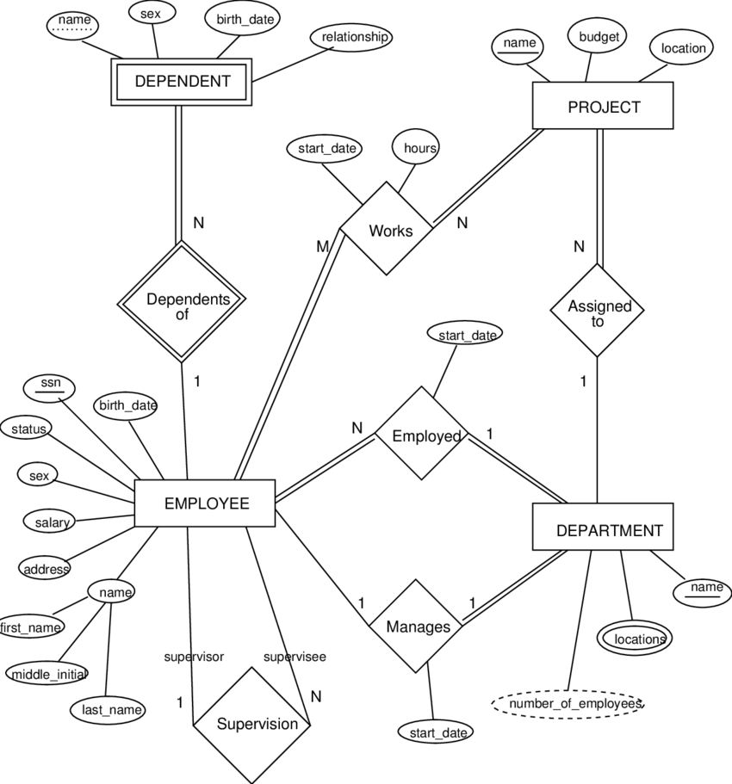
Redefine the Database

Slide 84
Daily Quiz
Which one of the following is a property of a weak entity type?
Cannot have its own key
May or may not have its own key
Need not have a key
none of the above
Which of the following is true
A weak entity must have partial constraint
A strong entity type must have total constraint
A weak entity type must have total constraint
A strong entity type must have partial constraint

Slide 85
Daily Quiz
Which of the following is the property of a strong entity type?
It must have a key
It may or may not have a key
It must have a weak entity type with it
Both A and C
Which of the following is true?
Recursive relationships must have a key
Recursive relationship have one entity type
Recursive relationship may have a key
4. None of the above

Slide 86
Daily Quiz
Which of the following is true?
A 1:N relationship can be represented as an attribute
A 1:1 relationship can be represented as an attribute
A N:M relationship can be represented as an attribute
Both A and B
Which of the following is true?
A total constraint can be represented as an attribute
A partial constraint can be represented as an attribute
Both A and B
4. None of the above

Slide 87
Subclasses and Superclasses
Subclasses and Superclasses
The entities that are members of the employee entity type may be
grouped. Further into Secretary, Engineer,
Manager, Technician, Salaried employee and Hourly employee.
The set of entities in each of the latter groupings is a
subset of the entities that belong to the employee
entity set, meaning that every entity that is a member
of one of these subgroupings is also an employee.
We call each of these subgroupings a subclass of the
employee entity type, and the employee entity type is
called the superclass for each of these subclasses.
The relationship between the superclass and subclass
is called a class/subclass relationship.

Slide 88
Subclasses and Superclasses
Specialization: is the process of defining a set of
subclasses of an entity type. This entity type is called
the superclass of the specialization.
The set of subclasses that form a specialization is
defined on the basis of some distinguishing
characteristics of the entities in the superclass.
e.g. The set of subclasses {Secretary, Engineer,
Technician} is a specialization of the superclass
employee that distinguishes among employee
entities based on the job type of each entity.

Slide 89
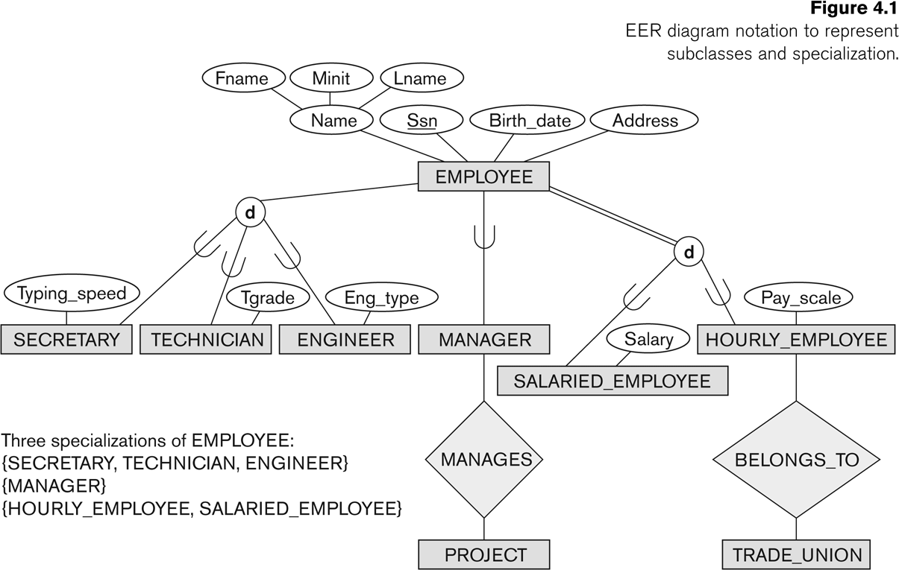
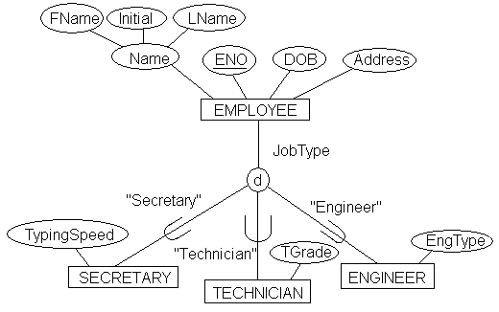
Subclasses and Superclasses

Slide 90
Subclasses and Superclasses
e.g. another specialization of the employee entity type
may yield the set of subclasses
{salaried_employee, hourly_employee}.
This specialization distinguishes among
employees based on the method of pay.
The reasons for having specialization:
1) Certain attributes may apply to some but not all
entities of the superclass. A subclass is defined in
order to group the entities to which these attributes
apply.
e.g. Secretary has attributes Typing Speed and Engineer
has attributes type of engineer.

Slide 91
Subclasses and Superclasses
2) Some relationship types may be participated in only
by entities that are members of the subclass. E.g.
if only hourly_employee can belong to a trade
union.
We can represent that fact by creating the sub
class hourly_employee of employee and relating
the subclass to an entity type trade_union via the
belongs_to relationship type.
Disjointness: The subclass of the specialization must be
disjoint, i.e. an entity can be a member of
at most one of the subclasses of the
specialization.

Slide 92
Subclasses and Superclasses
The disjoint is represented by the “d“ notation.
Generalization: The reverse of specialization is
generalization.
Consider Car and Truck, they can be generalized into
the entity type Vehicle. Both Car and Truck are now
subclasses of the generalized superclass vehicle.
Keys: A Superkey of a relation schema R={A_{1,}A_{2, …..} A_{n} }
is a set of attributes with the property that no two tuples t₁ and t₂ in any legal relation state r of R will have
T₁ [sk] = T₂ [sk]

Slide 93
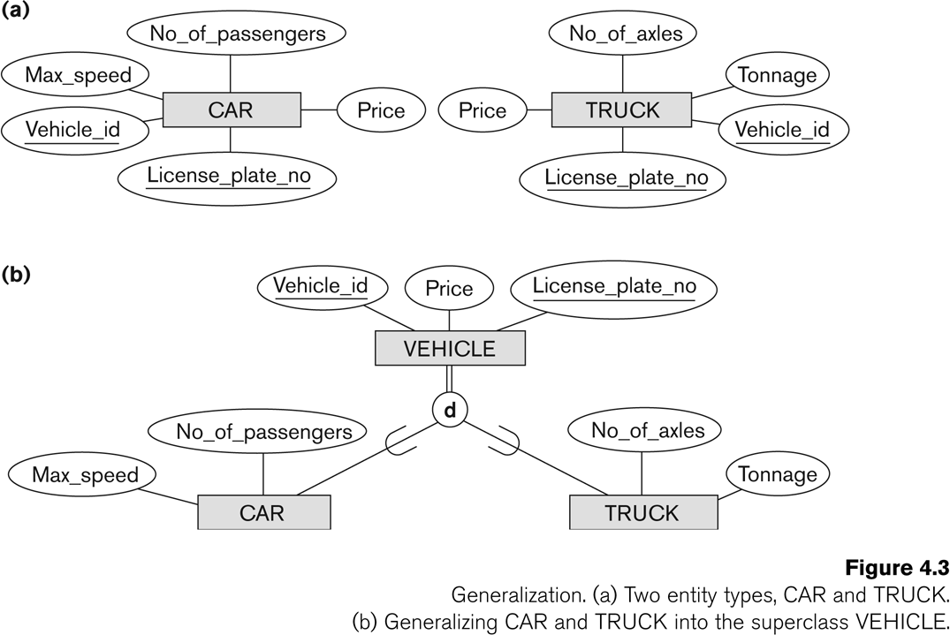
Generalization

Slide 94
Subclasses and Superclasses
A key k is a superkey with the additional property that
removal of any attribute from K will cause k not to be
a superkey anymore.
The difference between a key and a superkey is that a
key has to be minimal. That is if we have a key k = { A_{1,}
A_{2 ,} A_{3, ……..} A_{n}} of R then K – {A_{i}} is not a key of R for any i.
SSN is a key for employee, whereas {SSN, Ename} {SSN,
Ename, Bdate} etc are all superkeys.

Slide 95
Subclasses and Superclasses
A key k is a superkey with the additional property that
removal of any attribute from K will cause k not to be
a superkey anymore.
The difference between a key and a superkey is that a
key has to be minimal. That is if we have a key k = { A_{1,}
A_{2 ,} A_{3, ……..} A_{n}} of R then K – {A_{i}} is not a key of R for any
i.
If a relational schema has more than one key, each is
called a candidate key. One of the candidate keys is
arbitrarily designated to be the primary key and the
others are called secondary keys.

Slide 96
Aggregation
Aggregation is used when we have to define relationship among relationships.
In an ER diagram we cannot simply have a relationship with another relationship
We make an aggregate class first an then define a relationship with that aggregate class
Our aggregate class is composed of 2 entity types with a relationship between them .
Now this aggregate class is to be related with another relationship to indicate a relationship with another relationship.

Slide 97
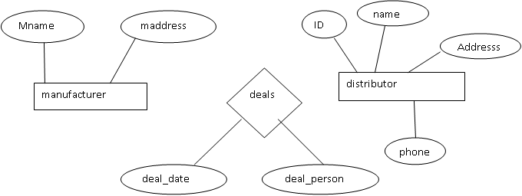
Aggregation
Let us take an example to explain this
Now if this deal results in supplying a product. then there exists a relationship among a relationship as follows:

Slide 98
Aggregation
^{MANUFACTURER}
^{DEALS}
^{DISTRIBUTOR}
^{SUPPLIES}
^{PRODUCT}
So this is not allowed in an er diagram to have a relationship with another relationship.

Slide 99
Aggregation
SO TO DO IT PROPERLY WE WILL HAVE TO MAKE AN AGGREGATE CLASS AND THEN THE RELATIONSHIP WILL EXIST BETWEEN THE AGGREGATE CLASS S FOLLOWS:
^{DEALS}
^{DISTRIBUTOR}
^{MANUFACTURER}
^{SUPPLIES}
^{PRODUCT}
Now the aggregate class is higher level abstract object.
To make it into an extended entity relationship model (eer model) ,
We will have to make the deals relationship a weak entity type which will be shown as follows:

Slide 100
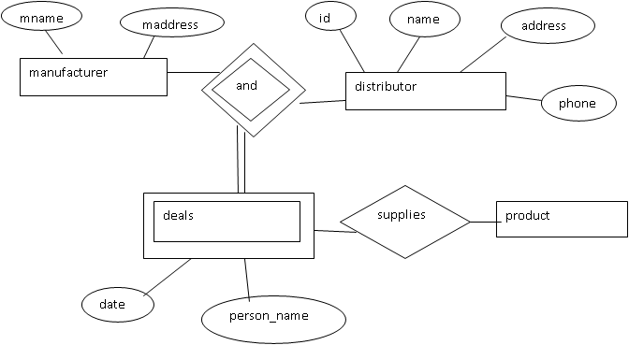
Aggregation

Slide 101
Daily Quiz
Which one of the following is a property of aggregation?
It represents a relationship
It is required to have relationship among relationship
It is the opposite of specialization
none of the above
Which of the following is true
Specialization is used to build subclasses
Generalization is to build subclasses
Generalization builds abstract classes
None of the above

Slide 102
Daily Quiz
Which one of the following is used for Abstract Classes?
Specialization
Generalization
Aggregation
none of the above
Which of the following is true
Specialization is used to build superclasses
Generalization is to build superclasses
Specialization builds abstract classes
None of the above

Slide 103
Daily Quiz
Which of the following represents disjointness?
Only one subclass must be chosen
Only one superclass must be chosen
Only one aggregate class must be chosen
None of the above
When a disjoint is there then the following is true?
The constraint should be total
The constraint should be partial
The constraint should be 1:N
4. The constraint should be N:M

Slide 104
SUMMARY
We have learnt the concepts of database systems, its advantages and its structure and how to draw the ER diagram. The relational model and how to reduce ER diagram into tables. The concept of Subclasses, Superclasses and aggregation.
THANKS

Slide 105
Faculty Video Links, Youtube & NPTEL Video Links and Online Courses Details
https://onlinecourses.nptel.ac.in/noc21_cs04/preview
https://nptel.ac.in/courses/106/106/106106093/
https://nptel.ac.in/noc/courses/noc18/SEM1/noc18-cs15/
https://www.coursera.org/learn/database-management
https://www.greatlearning.in/academy/learn-for-free/courses/database-management-systems-dbms
Notes:
https://www.youtube.com/watch?v=g6zGd6ycktY&list=PLo4R2IscWKdVqzh_QECsxCq7QB1CUpYfi&index=1

Slide 106
Weekly Assignment
DBMS basics Questions:-
Draw and ER diagram for a college Department.
What are the different types of users of a DBMS and
discuss their roles
What is an entity set, entity type, relationship set and
relationship instance
What is weak entity type
What is a recursive relationship.
What is Data Independence . Discuss its Type.
Discuss the different types of constraints in DBMS.

Slide 107
Old Question Papers
https://aktu.ac.in/pdf_old_q_paper/v-1068.pdf
https://www.aktuonline.com/papers/btech-cs-5-sem-database-management-system-ncs-502-2018-19.pdf
https://firstranker.com/fr.php/frdA290120A1619596/download-aktu-b-tech-5th-sem-2018-2019-rcs-501-data-base-management-system-question-paper
https://firstranker.com/fr.php/frdA290120A1619572/download-aktu-b-tech-5th-sem-2017-2018-ncs502-database-management-system-question-paper

Slide 108
Expected Questions for University Exam
DBMS basics Questions:-
What is the difference between a DBMS and
File Processing System
Describe the Concepts of Specialization and Generalization
Draw an ER Diagram for a Hospital. The date and time of
the tests done are recorded
Discuss all the types of attributes.
What is a key, a primary key, candidate key and super key.
Discuss the 3 tier architecture of a DBMS.

Slide 109
References
TEXT BOOKS:
(1) Elmasri, Navathe, “ Fundamentals of Database Systems”, Addision Wesley
(2) Korth, Silbertz, Sudarshan,” Database Concepts”, McGraw Hill
(3)Bipin C. Desai, “ An Introduction to Database Systems”, Gagotia Publications
(4) Majumdar & Bhattacharya, “Database Management System”, TMH

Slide 110
References
REFERENCES:
Archana Verma, Database Management Systems, Gyan Books
R.P. Mahapatra, Database Management System, Khanna Publishing House
Thank You

